Slide 1
MemorAI Week 5 Presentation 1
Alice Hua, Ajit Barhate, Tim Chen
Notes:
Just want to mention that we are in the process of pivoting. Just before this class, we met with the TA and we will try to address our direction as much as possible.

Slide 2
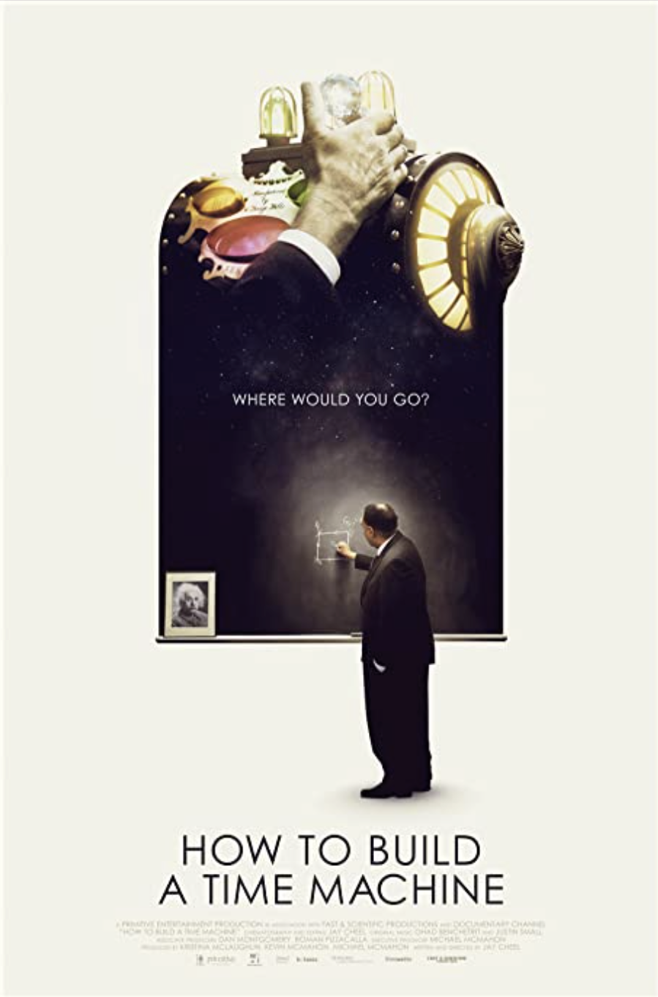
Notes:
Death is unavoidable.
“How to Build a Time Machine” is a documentary about a theoretical physics professor who has spent his entire career trying to build a time machine.
He wants to build the time machine because he wants to go back in time and talk to his father who passed away because of a heart disease when the professor was only 10.
The professor never has a chance to get to know his father, and he has a lot of questions that he wants to ask his father.

Slide 3
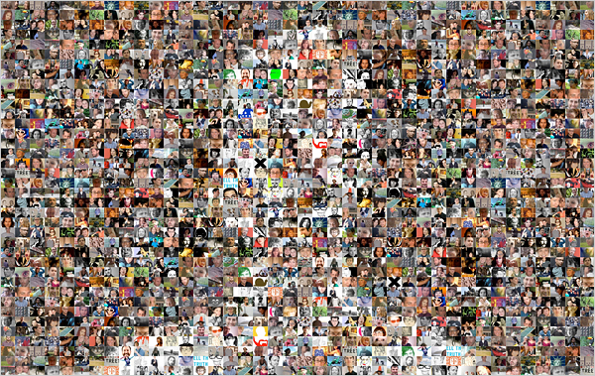
Problem
When our loved ones are gone, the memories about them fade away with time. For some, memories don’t even exist.
MemorAI
MemorAI solves the problem by preserving two things about our loved ones.
Life events we shared.
Who they are as a person.
E.g. Their point of view about life.
Notes:
When our loved ones pass away, all we have are our memories about them.
The problem is: Our memories fade away. In the case of the professor, he doesn’t even have those memories because he never got a chance to experience life with his father.
MemorAI solves the problem by preserving two things about our loved ones.
The life events we share with our loved ones.
Who they are as a person.

Slide 4
Two Customers
Friends & family of dying/deceased people.
Use Case: They want to remember their loved ones.
People who anticipate their own death. Use Case: People want to preserve a piece about themselves for their loved ones.
Notes:
We have two customers:
Our first customer is: The friends & family who want to remember about their loved ones.
Our second customer is the People who anticipate their own death.
This is a very important differentiation about our product.
We have strong evidence from our customer survey that, people do want to preserve a piece about themselves for their loved ones.
Note that our customers are not necessarily people who are dying.
Just like a will, we believe that people will want to start the process long before their death.

Slide 5
Friends & family Professor who wants to remembers about his father.
People who anticipate death Professor’s farther who wants to leave a piece about himself after he passes away.
Notes:
So going back to the professor who wants to build a time machine.
Both the professor and the professor’s farther are our customers. The professor wants to remember and get to know his father. And the professor’s farther, in anticipation of his own death, will want to preserve a piece about himself for his son.

Slide 6
Survey Findings
If you were about to pass away and have some time left, would you like to record your life stories?
86% Yes
14% No
If you know that your loved ones or friends are passing away, would you like them to record their life stories?
95% Yes
5% No
If yes, what would you like to preserve?
47% Life Events
15% Trips
38% Your philosophy and values about life
If there is only one thing you would like your loved ones to remember about you, what would it be?
How I felt about them, including how much I love them
How I impacted their life in a positive way
That they enriched my life more than they would ever know.
How I experienced the little things in life and the particular, peculiar things I found captivating and what I saw in them.
Age:
57% <35 yrs old
24% 35 - 55 yrs old
19% > 55 yrs old
Education Level:
90% College Grad
10% Some College
Race:
62% Asian
28% White
10% Others
Total respondents: 22
9/22/2021
Notes:
Here is a summary of the preliminary results from our survey.
First of all, the survey validates our assumption that both friends & family, AND the people who anticipate their own death can be our customers. Both customers want to preserve stories.
But the most important lesson we learn from the survey is that:
People don’t just want to preserve fun stories about them, such as a trip or vocation they have. They want to preserve what’s important to them in their own life.
And that includes both life events and their philosophical views about life.

Slide 7
Market Research
We’re working on a survey to validate our assumptions about customers.
Please help!
Notes:
With that said, our market research is ongoing. So please help us!

Slide 8
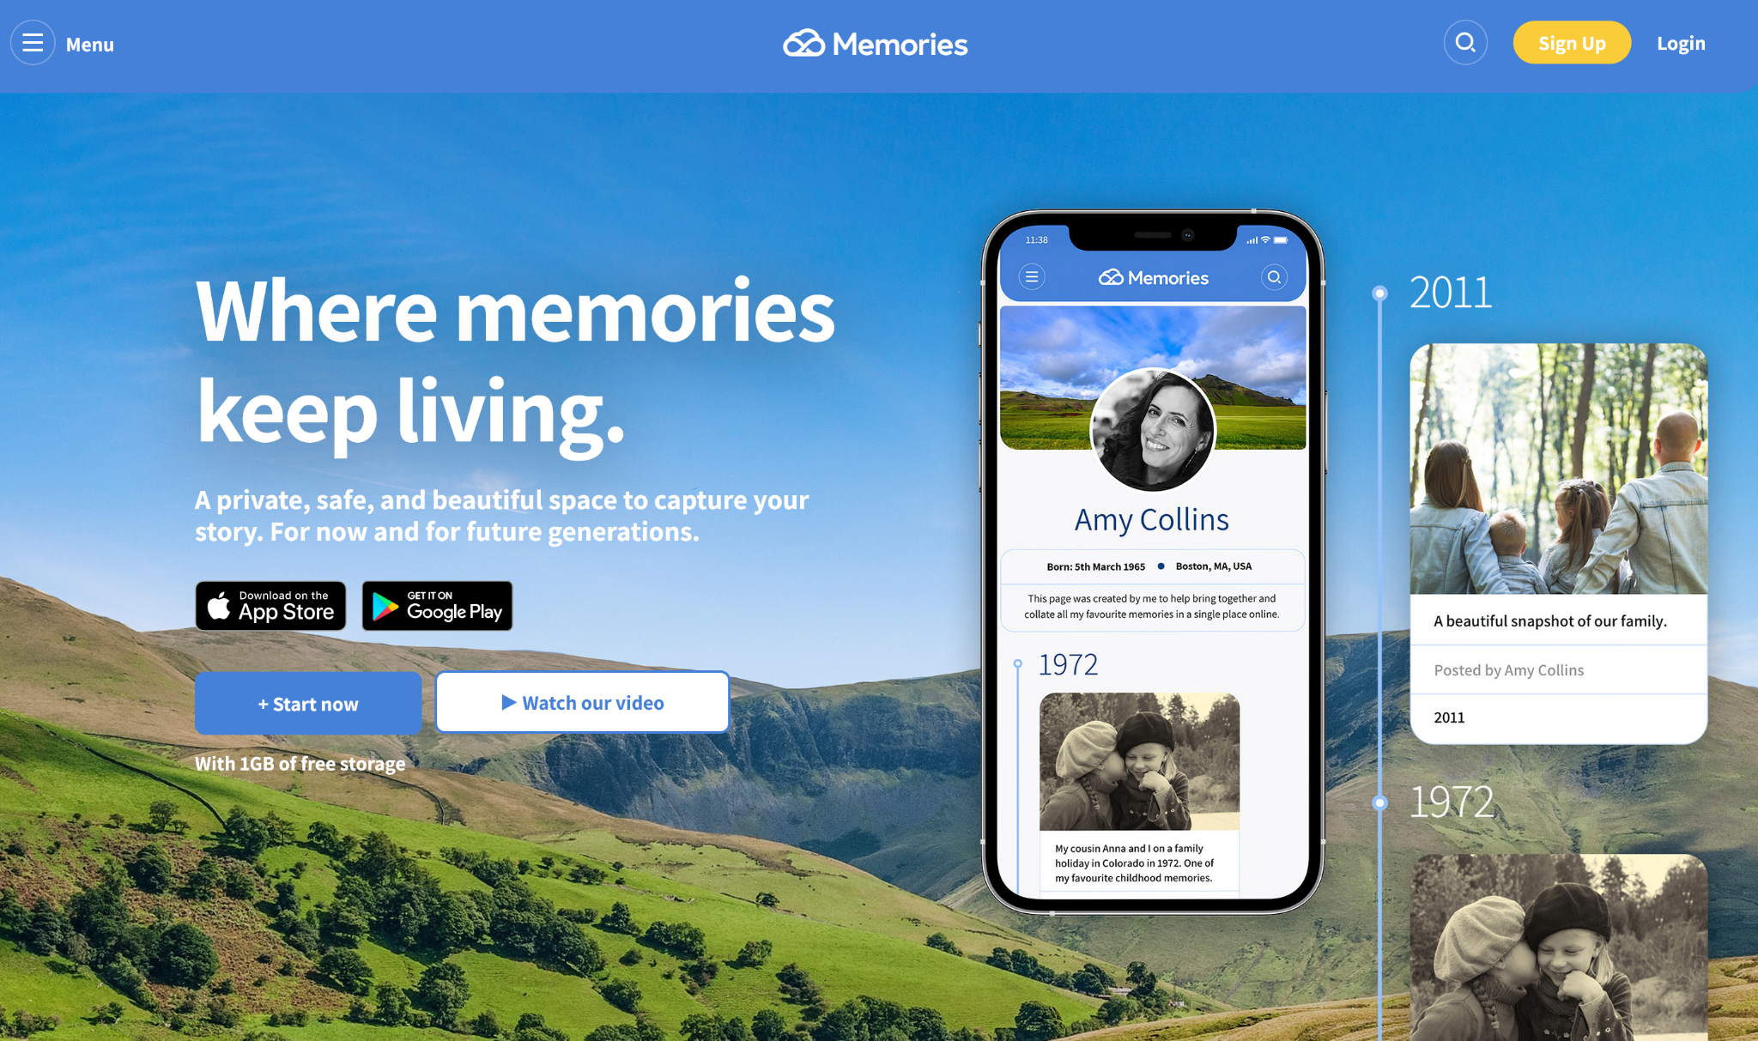
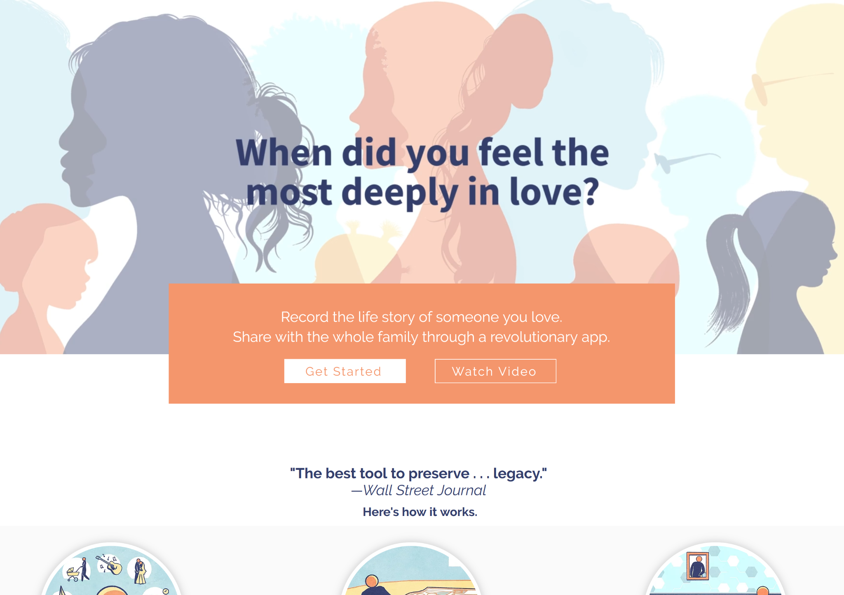
Competitors
Memories.net
Hereafter.ai
How are we different from existing products?
Notes:
AJIT
There are existing solutions out there such as Memories.net and Hereafter.ai that are the latest related products.
Memories.net allows to create a visual timeline
Hereafter.ai allows audio recordings of the life stroies from interviews of the person and provide interaction with it using their app.
Then there are memorial websites like forevermissed.com, where the content is created by friends and family. Not the person who passed away.

Slide 9
MemorAI - Product Differentiation
Tell your life stories, share precious moments and who you are as a person, the you want your future generations to know
The interviews are designed to capture these details
Use text and visuals (photos & videos) to celebrate your life stories and those precious moments
Friends and family will be able to contribute to your life moments with video & photos. These will be automatically tagged to enrich your appropriate life stories and moments you want your family to celebrate
Bring families and future generations together by leaving a strong bond behind you to celebrate life!
Notes:
AJIT
So how is MemorAI different from existing products?
Feedback from Tim: I think it’s important to mention the following differentiations:
We have interviews designed to capture the person’s life stories
Our product is designed for not just friends & family, but also the person anticipating death.
Note that I have change it from “person dying” to “person anticipating death”. The best analogy I can think of is the will that we create with our lawyer for our family. We do will not because we are dying, but because we anticipate that death can happen.
Now, this new definition of customer broadens our market.

Slide 10
MemorAI - Product Differentiation
Interaction with the product that will elicit meaningful response
Family & friends can contribute to your life stories
MemorAI
Life stories captured using text, photos & videos
Leave a strong bond behind you for family to celebrate life!
Notes:
AJIT
So how is MemorAI different from existing products?
The product will capture the personal life stories and who you are as a person through a well thought out interview process, the way you want to capture your stories. That will allow the family & friends to have product interaction to elicit meaningful response
The life stories can be captured using text, photos and video
Importantly, your family and friends can contribute to your life stories using media file.
And if there is one single thing that we want to call out as a differentiation then it is - the strong bond that you leave behind for your family to come together and celebrate life!

Slide 11
$3.6B Service Addressable Market Opportunity in US Alone
Targeting one out of every tenth family in the US, the service addressable market opportunity is $3.6B
The subscription based annuity business opportunity of $1B (part of $3.6B)
There are adjacencies to the core product to further monetize.
Notes:
AJIT
The estimated service addressable market in US alone is $3.6.
When we expand this product to new geographies then it will create even bigger market opportunity.

Slide 12
$3.6B Service Addressable Market Opportunity in US Alone
Targeting one out of every tenth family in the US, the service addressable market opportunity is $3.6B
The subscription based annuity business opportunity of $1B (part of $3.6B)
There are adjacencies to the core product to further monetize.
Notes:
AJIT
The estimated service addressable market in US alone is $3.6.
When we expand this product to new geographies then it will create even bigger market opportunity.

Slide 13
MVP & Challenges
Notes:
TIM

Slide 14
MVP: 2 Phases
Preserve life stories about our loved ones.
Preserve who our loved ones are as a person.
Phase 1
Phase 2
Notes:
ALICE
What does it mean to capture somebody as a person?

Slide 15
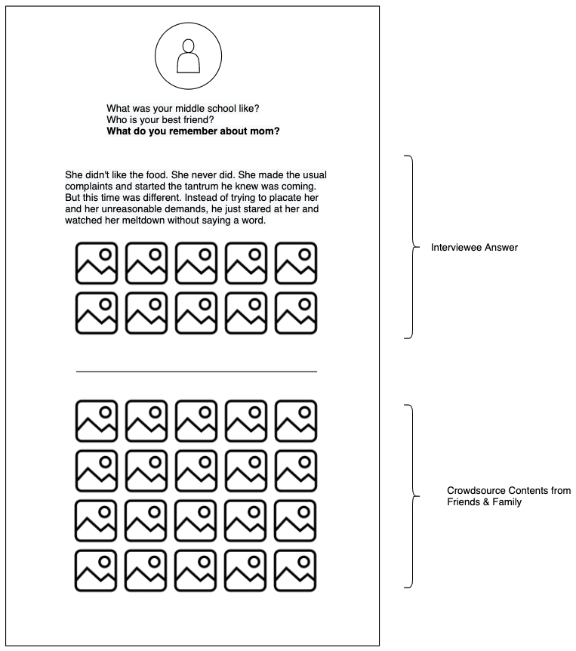
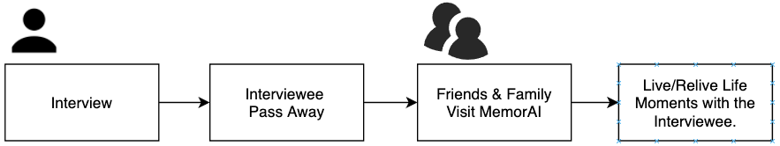
Phase 1 - Preserving Life Stories
Notes:
ALICE

Slide 16
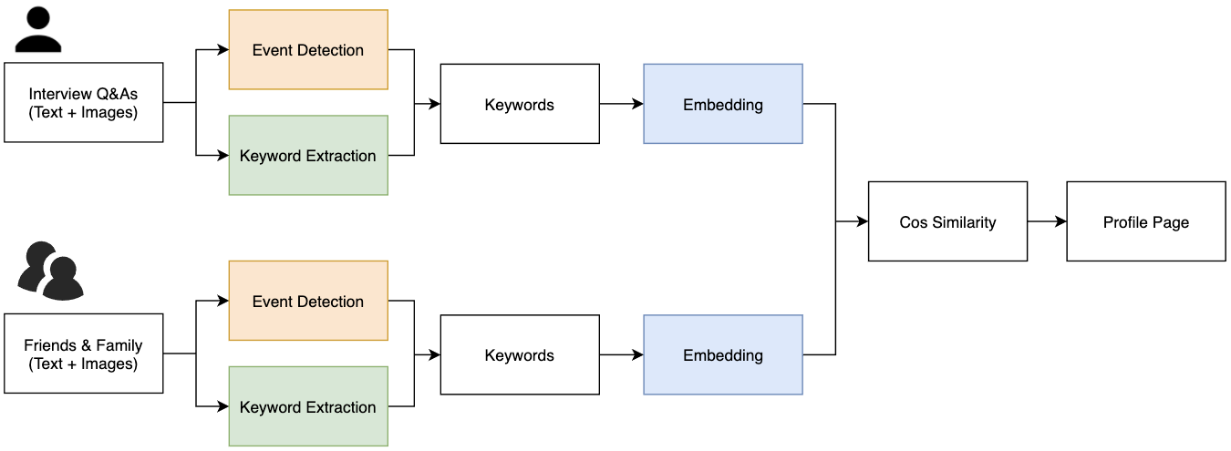
Phase 1 - Preserving Life Stories
Notes:
ALICE

Slide 17
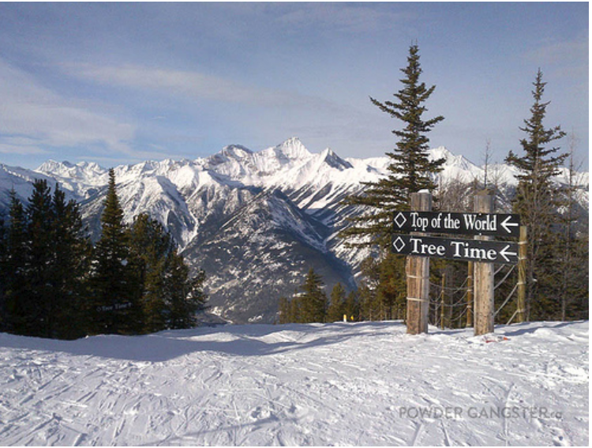
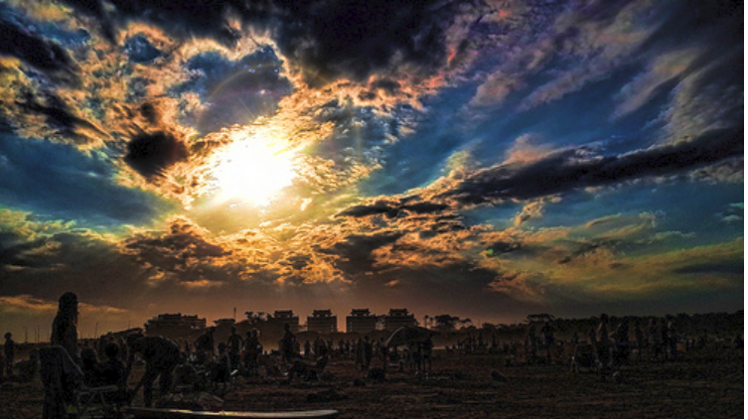
Initial Phase I EDA
Total size: 500,000 images with 14 social events
Subset: 187,617 images with 8 social events
Concert Graduation Meeting Mountain Trip Picnic Sea Holiday Ski Holiday Wedding | Conference Exhibition Fashion Protest Sport Theater
Findings: one image can belong in 2 events
Notes:
ALICE

Slide 18
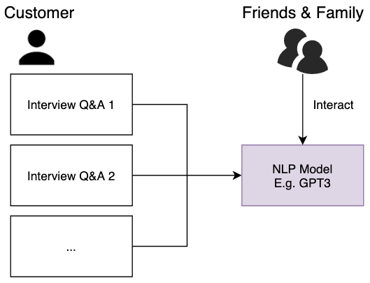
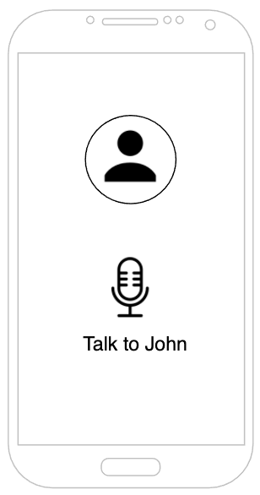
Phase 2 - Preserving Who Our Loved Ones Are
Notes:
ALICE
What does it mean to capture somebody?
How can we build a bot that communicates in the likeness of the person
If we know someone with a terminal illness, they go through interview or some long form recordings, we transcribe them into text, feed the model and have specific categories for (Q&A)
In 1900 we write something about somebody
In 2000s we try to build a bot of that person
How close are we to that?
We know it sounds ridiculous but bare with us?

Slide 19
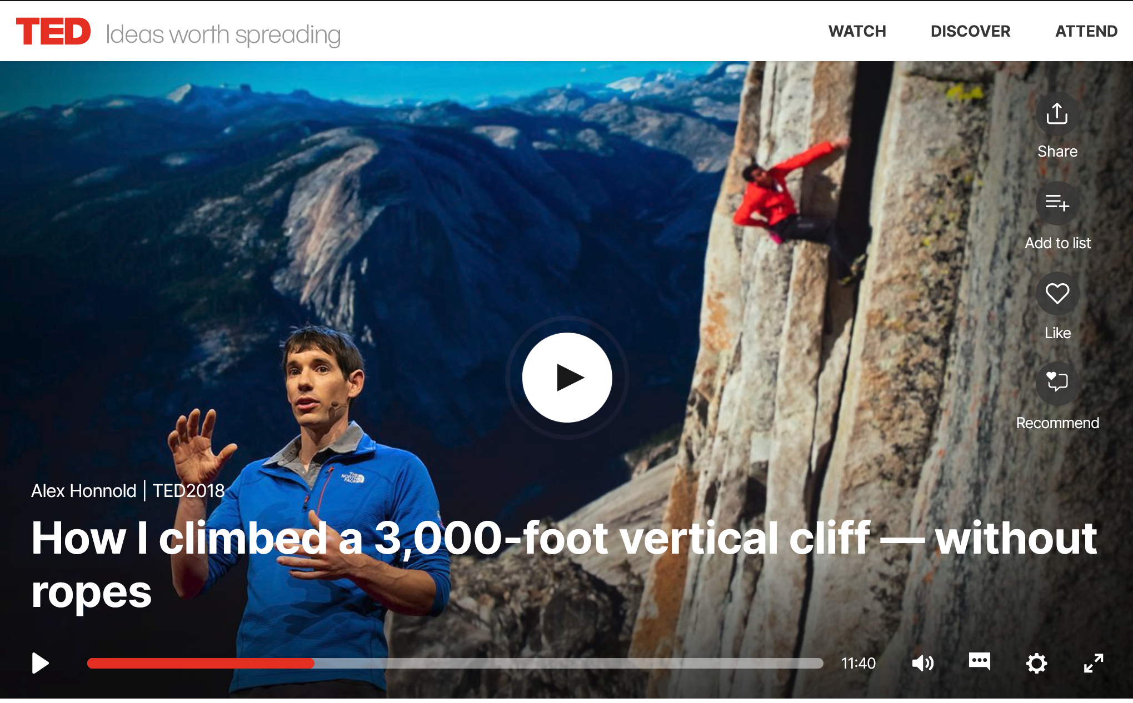
Initial Phase II EDA
Original transcript:
Hello. I'd like to show you guys 30 seconds of the best day of my life.,So that was El Capitan in California's Yosemite National Park, and in case you couldn't tell, I was climbing by myself without a rope, a style of a climbing known as free soloing. That was the culmination of a nearly decade-long dream, and in the video I'm over 2,500 feet off the ground. Seems scary? Yeah, it is, which is why I spent so many years dreaming about soloing El Cap and not actually doing it. But on the day that that video was taken, it didn't feel scary at all. It felt as comfortable and natural as a walk in the park, which is what most folks were doing in Yosemite that day.,Today I'd like to talk about how I was able to feel so comfortable and how I overcame my fear. I'll start with a very brief version of how I became a climber, and then tell the story of my two most significant free solos. They were both success
GPT-2:
They were both success stories and some form of true triumph. I was actually starting to see something from their story, and it gave me a great deal of courage. After doing some of the free solos with me – at 8.7% above my own record – and being able to climb those with a rope (after climbing by myself in the dark), it was time to start making a plan.I was really happy that I could do this"
Findings: generative texts == false information?
Alex Honnold’s MemorAI
Q: Why do you free solo?
A: I free solo because ...
Notes:
ALICE
A POC captures one aspect one the person?
When GPT asks a question, we will need to score how accurate an answer is.

Slide 20
MVP Scope & Feasibility
No videos
Data source change?
USED | NPRStoryCorp | Economist Obituaries | TedTalks | Internet footprints
Generative model: evaluation challenge
Additional resources: Need more technical help
Privacy: profiles are private & users only submit what they want to be used
Notes:
ALICE
Generative model: Ask someone who knows Alex to be the sounding board (give a score range) about how much the bot captures

Slide 21

Initial Challenges
Datasets
Internet footprint: webscrape as much information as possible of what this person left behind
Demo: interview -> transcribe, photos if there’s time
Currently considering famous ppl, movie characters, ourselves (choose 1)
NLP Evaluation
How do we know how accurate GPT can represent a person? Perplexity metric not enough?
Customer Validation
Pre-product survey is being filled out
End user testing needs to be evaluated by people who know this person.

Slide 22
Appendix

Slide 23
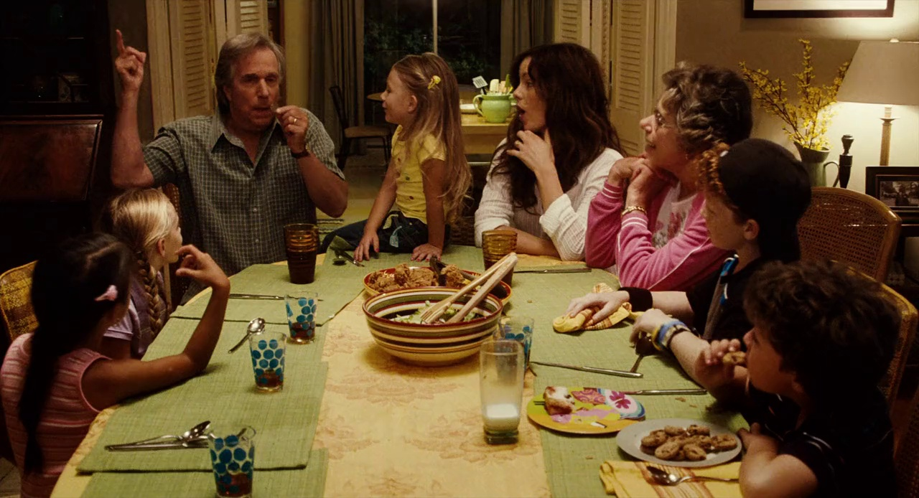
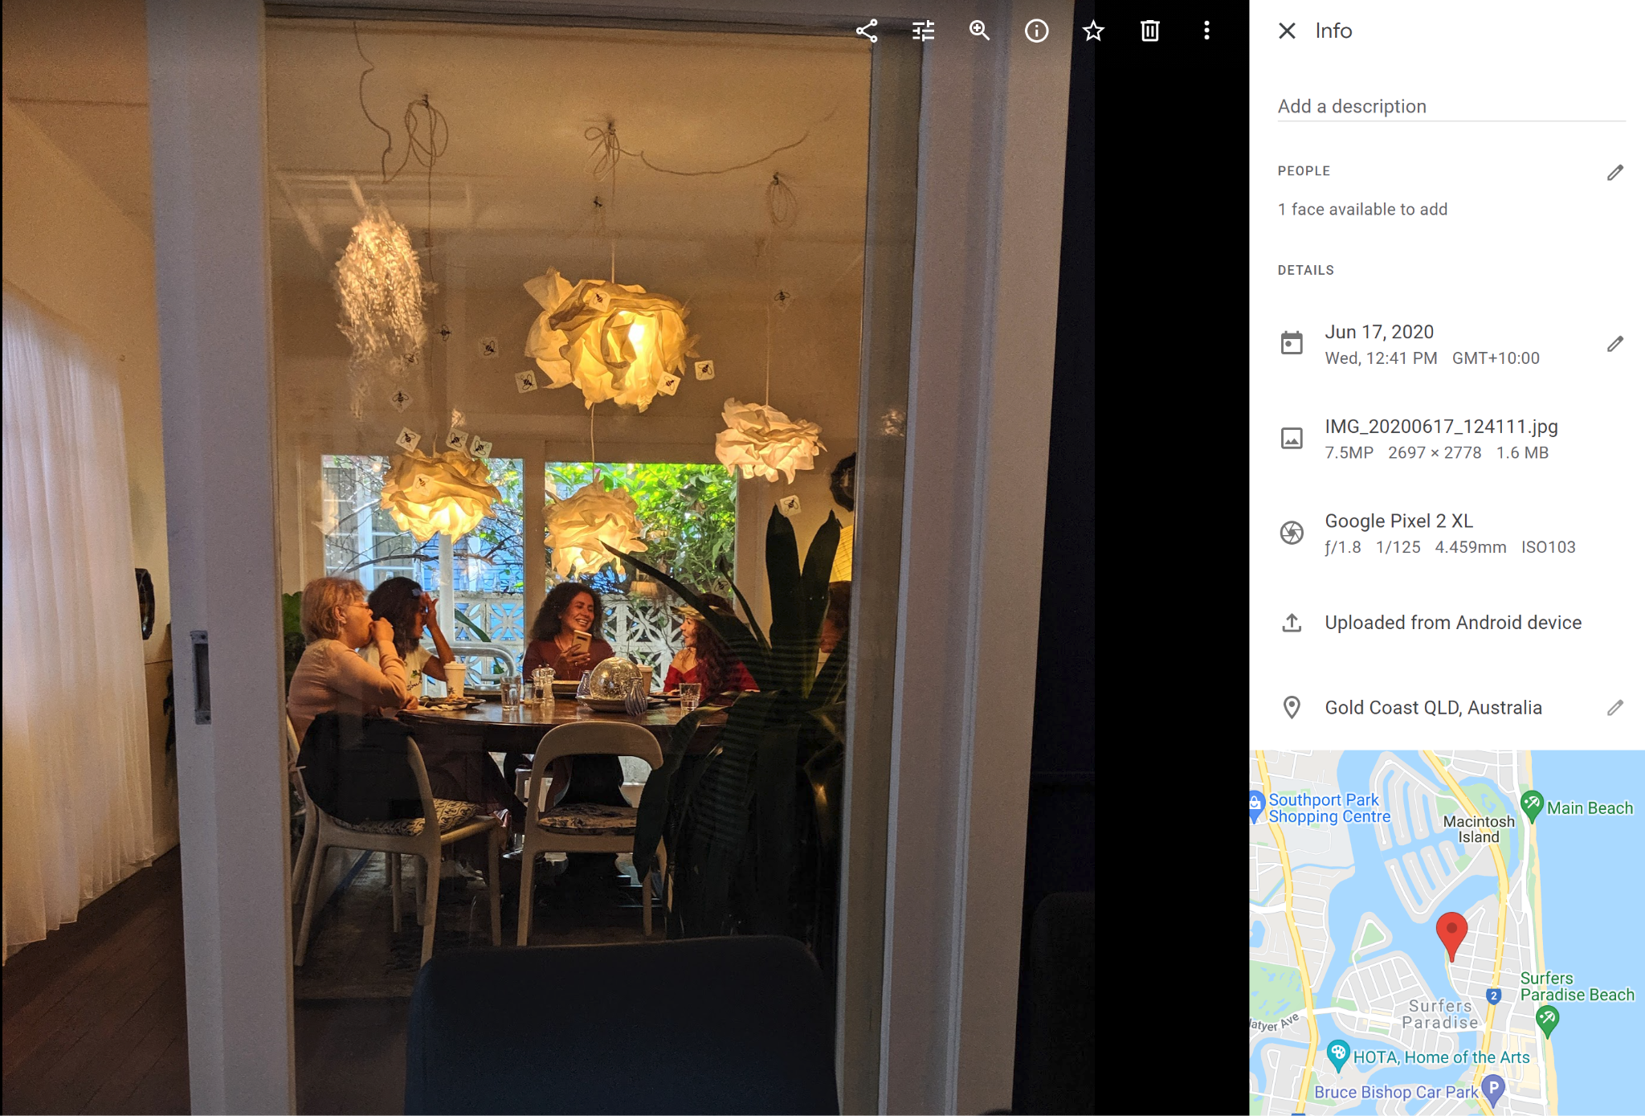
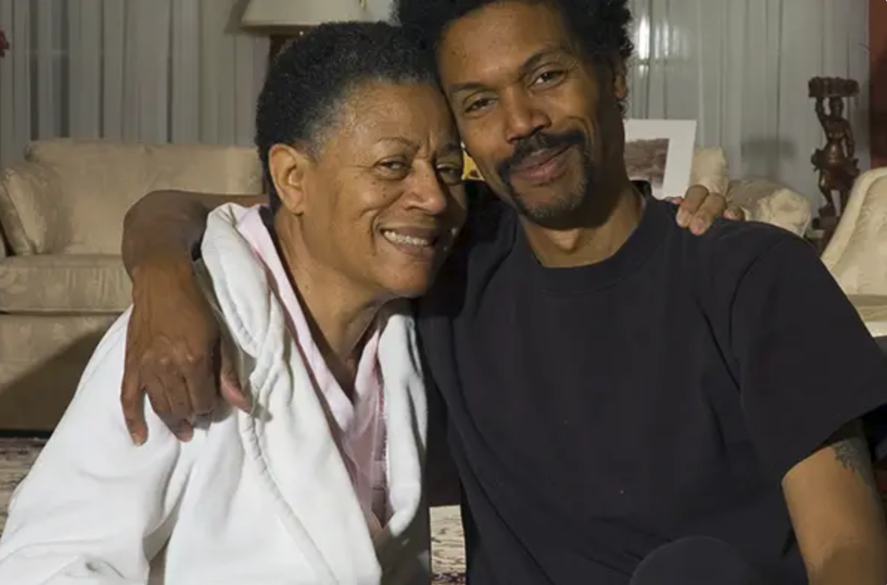
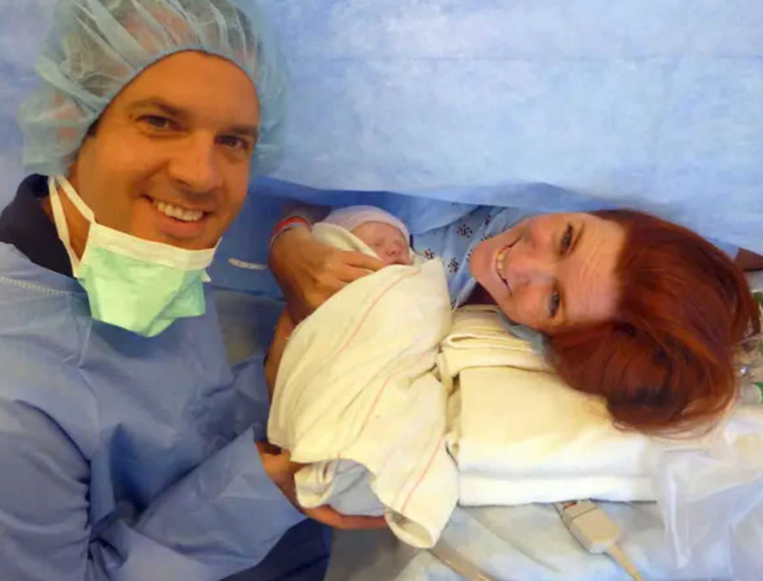
Family reunion
Friends reunion
Mom’s birthday
Birth of your child
Notes:
“How to Build a Time Machine” is a documentary about a theoretical physics professor from the University of Connecticut who has spent his entire career trying to build a time machine.
He wants to build the time machine because he wants to go back in time and talk to his father who passed away because of a heart disease when the professor was only 10 years ago.
The professor has so many questions about life he wants to ask his father.
As we will explain in phase I of the project, we’ll focus on life events, a few notable ones include family & friend reunios and birthdays, etc
In the movie, the son never got to experience these live events with his father. We therefore think it’s much more meaningful for us to work on phase II, build a model that allows this physic teacher, the son, to interact with his dad.

Slide 24
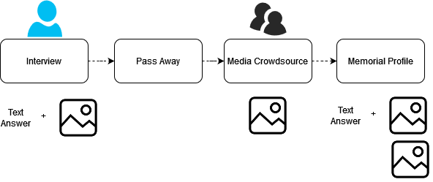
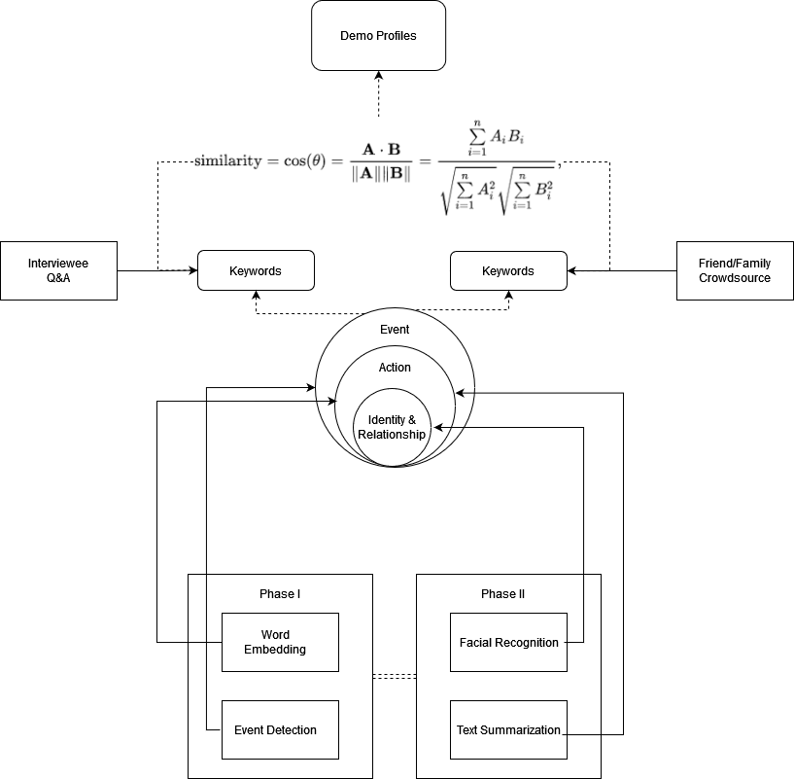
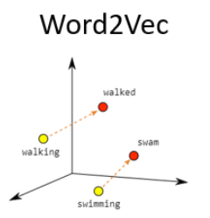
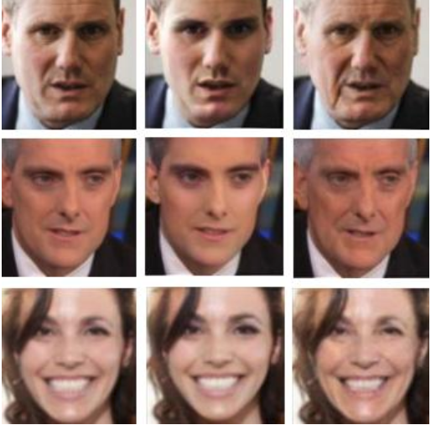
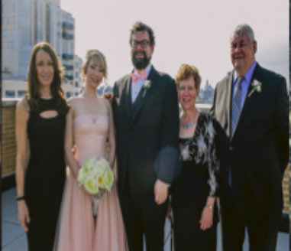
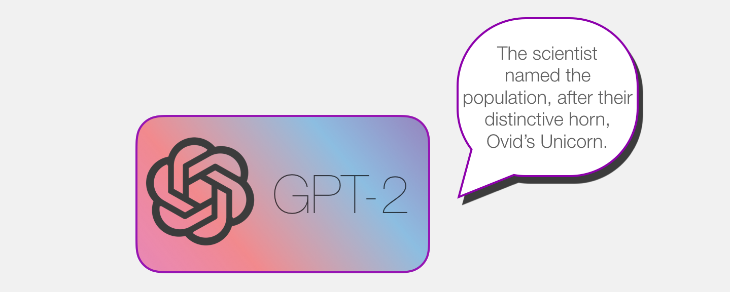
Approach
Process & Mockup
Pipeline
MVP
Notes:
ALICE

Slide 25
Guardrail Models
Model | BERTopic
Training | Fine-tuned on train set
Learning | Two-step search (keyword & semantic)
Params | max_rank
Dataset | 655documents
Model | BERTopic
Training | None
Learning | Two-step search (keyword & semantic)
Params | max_rank
Dataset | 711 documents

